Slide 1
Transportation Model

Slide 2

Sources Mileage Chart
1000 a₁
b₁ 2300
1500 a₂
b₂ 1400
1200 a₃
8 cents per mile per car
Min 80x₁₁ + 215x₁₂ + 100x₂₁ + 108x₁₂ + 102x₃₁ + 68x₃₂
x₁₁ + x₁₂ ` = 1000
x₂₁ + x₂₂ = 1500 Supply
x₃₁ + x₃₂ = 1200
x₁₁ +x₂₁ + x₃₁ = 2300
x₁₂ + x₂₂ + x₃₂ = 1400
x_{ij} $≥0$ i = 1, 2, 3; j = 1, 2
1
 | Denver | Miami
LA | 1000 | 2690
Detroit | 1250 | 1350
New Orleans | 1275 | 850
1
2
2
3
 | Denver | Miami
LA | $80 | $215
Detroit | $100 | $108
New Orleans | $102 | $68
Demand

Slide 3
 | Denver | Miami | Supply
LA | 1000 |  | 1000
Detroit | 1300 | 200 | 1500
New Orleans |  | 1200 | 1200
Demand | 2300 | 1400
80
80
100
108
102
68

Slide 4
Balancing the transportation model
 | Denver | Miami | Supply
LA | 1000 |  | 1000
Detroit | 1300 | 200 | 1500
New Orleans |  | 1200 | 1200
Dummy Plant |  | 200
Demand | 2300 | 1400
Supply < Demand
80
80
100
108
102
68
0
0
200
Dummy Supply
Shortage at Miami

Slide 5
The Transportation Algorithm
Starting basic feasible solution
Entering variable – optimality condition
Leaving variable – feasibility condition

Slide 6
Cost Matrix of SunRay Transport
Mill
Non-artificial m+n-1 basic variables
Starting solution :
North-West Corner method
 | 1 | 2 | 3 | 4 | Supply
Silo | 10 | 2 | 20 | 11 | 15
 | 12 | 7 | 9 | 20 | 25
 | 4 | 14 | 16 | 18 | 10
Demand | 5 | 15 | 15 | 15
 | 1 | 2 | 3 | 4 | Supply
1 | 5 | 10 |  |  | 15
2 |  | 5 | 15 | 5 | 25
3 |  |  |  | 10 | 10
Demand | 5 | 15 | 15 | 15
10
2
20
11
$520
12
7
9
20
4
14
10
18

Slide 7
Least cost Method
 | 1 | 2 | 3 | 4 | Supply
1 |  | 15 (start) |  | 0 | 15
2 |  |  | 15 | 10 (End) | 25
3 | 5 |  |  | 5 | 10
Demand | 5 | 15 | 15 | 15
$475

Slide 8
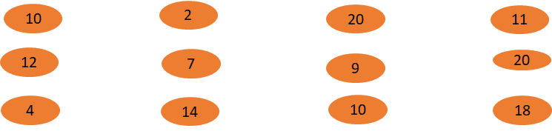
Vogel Approximation Method (VAM)
Row Penalty
10 – 2 = 8 9
9 – 7 = 2 2
14 – 4 = 10 2
 | 1 | 2 | 3 | 4 | Supply
1 |  |  |  |  | 15
2 |  |  |  |  | 25
3 | 5 |  |  |  | 10
Demand | 5 | 15 | 15 | 15
$475
Max. of Row & Column penalty
Delete only 1 row/column at a time
If simultaneously supply & demand satisfied, leads to degenerate BFS

Slide 9
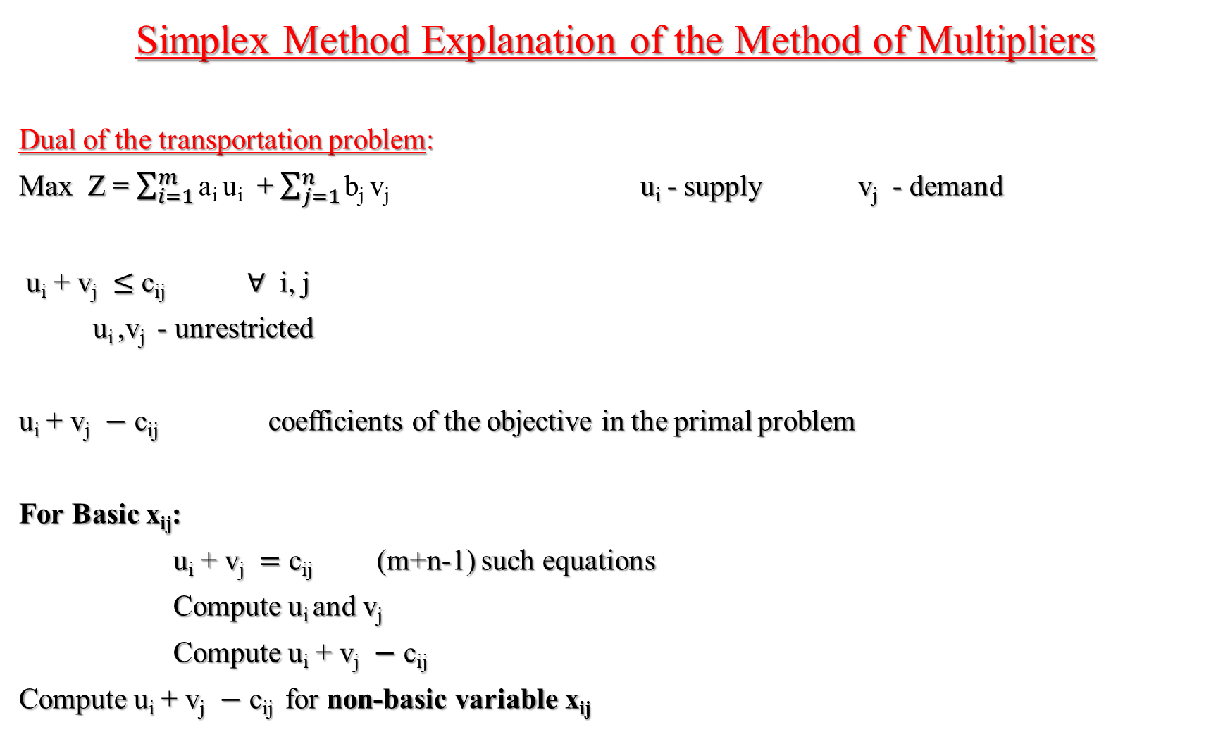
Simplex Method Explanation of the Method of Multipliers
Dual of the transportation problem:
Max Z = $\sum_{i=1}^{m}{\text{a}\text{i} \text{u}\text{i} }$ + $\sum_{j=1}^{n}{\text{b}\text{j} \text{v}\text{j} }$ u_{i} - supply v_{j} - demand
u_{i} + v_{j} $≤$ c_{ij} $∀$ i, j
u_{i} ,v_{j} - unrestricted
u_{i} + v_{j} $−$ c_{ij} coefficients of the objective in the primal problem
For Basic x_{ij}:
u_{i} + v_{j} $=$ c_{ij} (m+n-1) such equations
Compute u_{i} and v_{j}
Compute u_{i} + v_{j} $−$ c_{ij}
Compute u_{i} + v_{j} $−$ c_{ij} for non-basic variable x_{ij}

Slide 10

For Basic x_{ij}:
u_{i} + v_{j} $=$ c_{ij} Solution
x₁₁ : u₁ + v₁ = 10 u₁ = 0 v₁ = 10
x₁₂ : u₁ + v₂ = 2 u₁ = 0 v₂ = 2
x₃₄ : u₃ + v₄ = 18 u₃ = 3 v₄ = 15
 | 1 | 2 | 3 | 4 | Supply
1 | 5 | 10 |  |  | 15
2 |  | 5 | 15 | 5 | 25
3 |  |  |  | 10 | 10
Demand | 5 | 15 | 15 | 15

Slide 11

u_{i} + v_{j} $−$ c_{ij} for Non-Basic x_{ij}:
Non-Basic u_{i} + v_{j} $−$ c_{ij}
x₁₃ u₁ + v₃ $−$ c₁₃ = -16
x₁₄
x₂₁
x₃₁ u₃ + v₁ $−$ c₃₁ = 9
x₃₂
x₃₃ u₃ + v₃ $−$ c₃₃ = -9
v₁ = 10
v₂ = 2
v₃ = 4
v₄ = 15
u₁ = 0
5 | 10 |  |  | 15
 | 5 | 15 | 5 | 25
 |  |  | 10 | 10
5 | 15 | 15 | 15
-16
4
u₂ = 5
3
u₃ = 3
9
-9
-9

Slide 12

5 - Ɵ | 10 + Ɵ
 | 5 - Ɵ | 15 | 5 +Ɵ
Ɵ |  |  | 10 - Ɵ
5 – Ɵ $≥0$
10 – Ɵ $≥0$
Ɵ $≤5$ ; Ɵ_{max} = 5

Slide 13
Ɵ = 10
 | 15 - Ɵ |  | Ɵ
 | 0 + Ɵ | 15 | 10 - Ɵ
5 |  |  | 5
-9
-16
4
-6
-9
-9
 | 5 |  | 10
 | 10 | 15
5 |  |  | 5
-13
-16
-10
-4
-5
-5

Slide 14
The Assignment Method

Slide 15
1 2 3 ………...... n
Supply
1
2
N
1
1
1
Workers
Demand
1 1 1 ………...... 1
Special case of Transportation model

Slide 16
Hungarian Method
 | Mow | Paint | Wash
**** | $15 | $10 | $9
**** | $9 | $15 | $10
**** | $10 | $12 | $8
p₁ = 9
p₂ = 9
p₃ = 8
6 | 1 | 0
0 | 6 | 1
2 | 4 | 0
q₁ = 0
q₂ = 1
q₃ = 0

Slide 17
6 |  | 0
 | 5 | 1
2 | 3
0
0
0

Slide 18
If there is no feasible assignment
1
2
3
4
1
1 | 4 | 6 | 3
9 | 7 | 10 | 9
4 | 5 | 11 | 7
8 | 7 | 8 | 5
2
3
4
1
2
3
4
1
0 | 3 | 2 | 2
2 | 0 | 0 | 2
0 |  | 4 | 3
3 | 2 | 0 | 0
2
Subtract 1 from each uncovered element
3
1
4

Slide 19
1
2
3
4
1
 | 2 | 1 | 1
3 | 0 |  | 2
0 |  | 3 | 2
4 | 2 | 0
0
2
0
3
0
4
0

Slide 20

Simplex Explanation
Min Z = $\sum_{i=1}^{n}{\sum_{j=1}^{n}{\text{c}\text{ij} \text{xij} }}$
$\sum_{i=1}^{n}{ \text{xij} }$= 1 i = 1,2,………………n
$\sum_{j=1}^{n}{\text{x}\text{ij}}$= 1 j = 1,2,………………n
$\text{x}\text{ij}$ $ε$ {0,1}
c’_{ij} = c_{ij} – p_{i} –q_{j}
$\sum_{i=1}^{n}{\sum_{j=1}^{n}{\text{c}\text{′}\text{ij}\text{x}\text{ij}}}$ = $\sum_{i=1}^{n}{\sum_{j=1}^{n}{\text{c}\text{ij}\text{x}\text{ij}}}$ - $\sum_{i}{p_{i}}$ $\sum_{j=1}^{n}{\text{x}\text{ij}}$ - $\sum_{j}{\text{q}\text{j}}$ $\sum_{i=1}^{n}{\text{x}\text{ij}}$
= $\sum_{i=1}^{n}{\sum_{j=1}^{n}{\text{c}\text{ij}\text{x}\text{ij}}}$ - $\sum_{i}{p_{i}}$ - $\sum_{j}{\text{q}\text{j}}$
constant

